Slide 1
D-110 Unit 8: Supplemental and Manual Resource Order Forms
Notes:
Course: Expanded Dispatch Recorder, D-110
Unit 8: Supplemental and Manual Resource Order Forms
Time: 1 Hour

Slide 2

Objectives
Identify forms that supplement the Resource Order form
Complete a hardcopy of the Resource Order Form
Notes:
Present unit objectives.

Slide 3
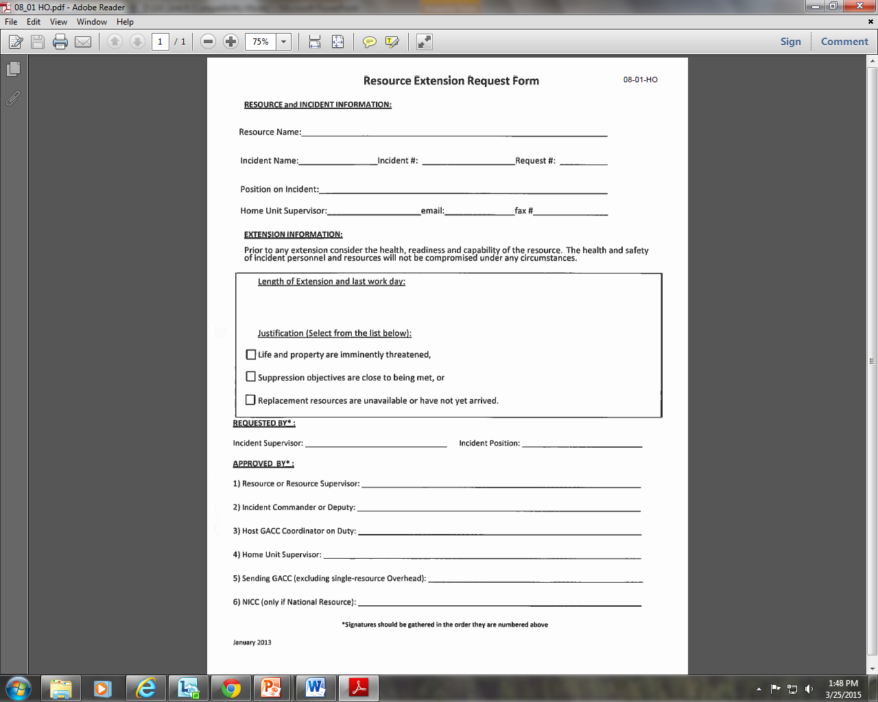
Resource Extension Request
Notes:
Resource Extension Request Form - Refer to: Resource Extension Request Form Handout
Used to extend resources on incident.
EDRC will notify EDSD or EDSP when an Extension Form is received.
National resources require NICC approval to extend.
Discuss local protocol.

Slide 4
Aircraft Flight Request Form
Notes:
Aircraft Flight Request Form - Refer to: Aircraft Flight Request / Flight Schedule Handout
Used to request aircraft to transport personnel and/or supplies.
Shows aircraft used, personnel/supply transported and is used for payment information.
Provides ETD/ETA information.

Slide 5
Passenger and Cargo Manifest
Notes:
Passenger and Cargo Manifest – Refer to: SF 245 Passenger and Cargo Manifest Populated Handout
Identifies personnel and/or cargo being transported.
Generally used for crews and engines

Slide 6
Preparedness / Detail Request
Notes:
Preparedness/Detail Request – Refer to: Detail Request Handout
Used to request individual resource for extended or prearranged assignments.
Can be used for overhead, equipment, and crews.
Follow local protocol, does not use fire codes.

Slide 7
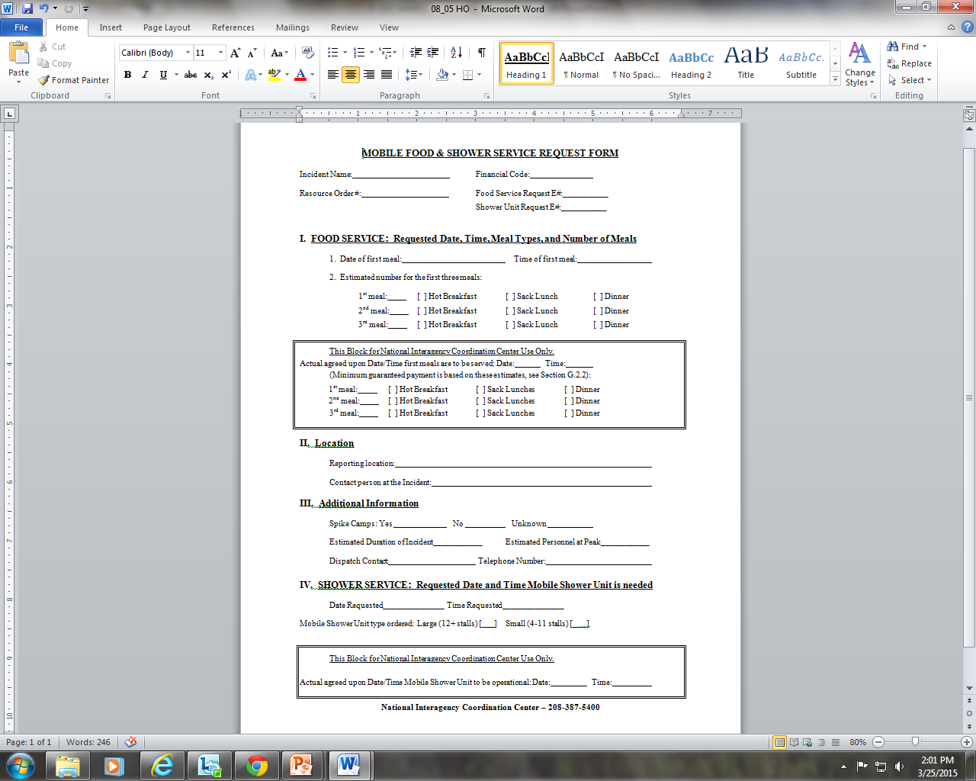
Mobile Food and Shower Request
Notes:
Mobile Food and Shower Service Request Form – Refer to Mobile Food Service Request Form
Provides the information required by NICC to fill the request.
Useful as a checklist to ensure everything is ordered prior to arrival.
Required to order a national caterer or shower.
EDRC would only fill out this form with the help of an EDSD or EDSP. Discuss where and how you might get some of the information required for the form (example: number of meals).

Slide 8
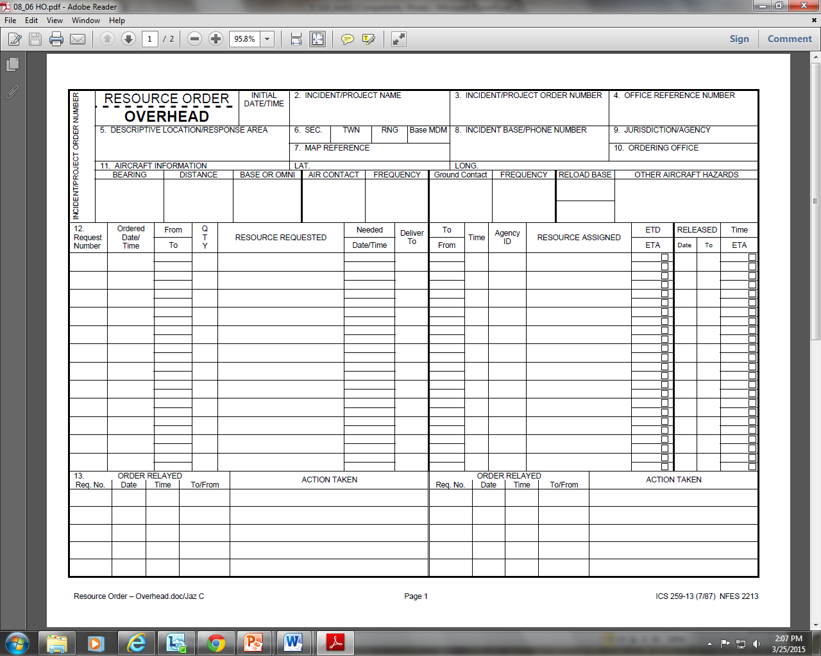
Manual Resource Order Form
Notes:
HARDCOPY RESOURCE ORDER
The hardcopy resource order form is used to manually document resource requests when the electronic resource tracking system (IROC) is unavailable.
Legal Documents
Resource order forms and all supplemental forms are legal documents that can be subpoenaed and used in lawsuits.
Question: What does an EDRC need to consider when completing any form - electronic or hard copy?
Possible answers: Be professional, state facts, be accurate and thorough, try to be legible, etc.
Completed Resource Order forms are part of the final financial package.
Description of the Form – Refer to: Resource Order Supply BLANK
Each functional area has its own form. On original cardstock, each functional area has its own color: Crews/Green; Overhead/White; Equipment/Goldenrod; and Supplies/Brown.
Hardcopy resource orders are no longer being produced. They are available for printing online. Discuss local protocols.
There are three main sections on the form:
Header information (Blocks 1- 11)
Resource information (Block 12)
Receive request
Place request
Assign resource and relay information
Release resource
Documentation (Block 13)
Documentation block is continued on the back of the form.

Slide 9
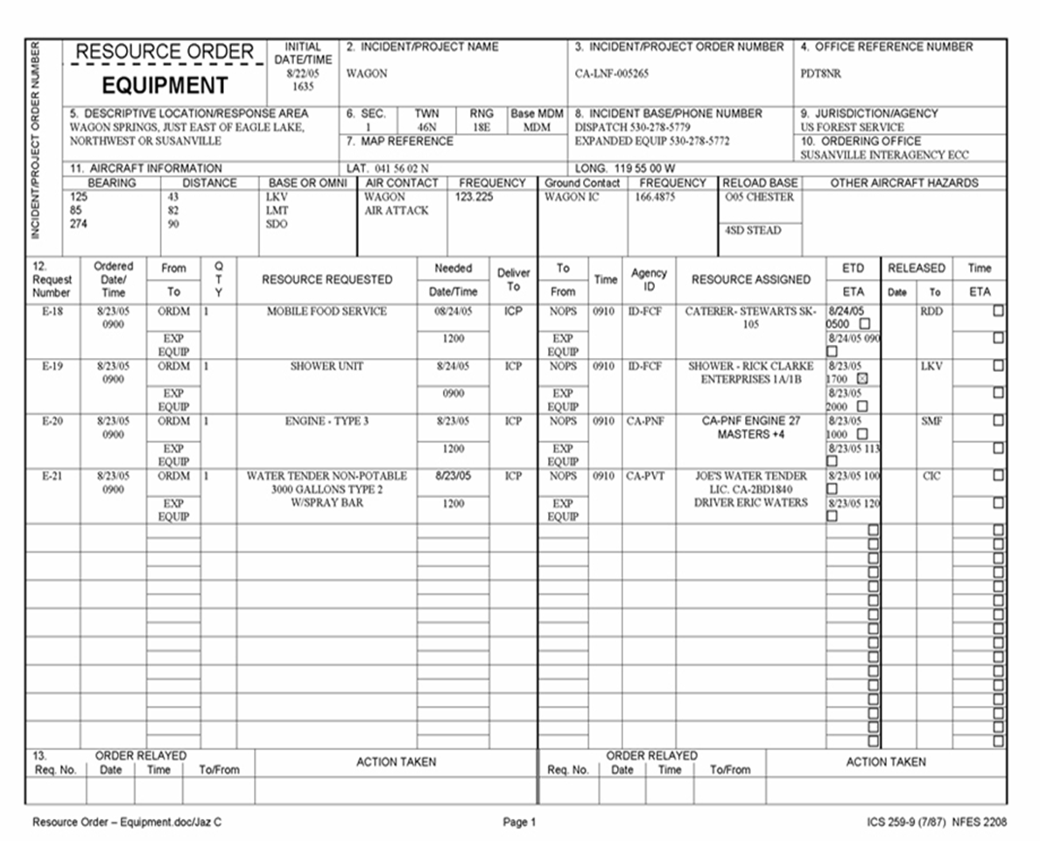
Resource Order Equipment
Notes:
Examples of Completed Forms
Display each completed Resource Order form and describe to students each of the three sections described above.
Equipment

Slide 10
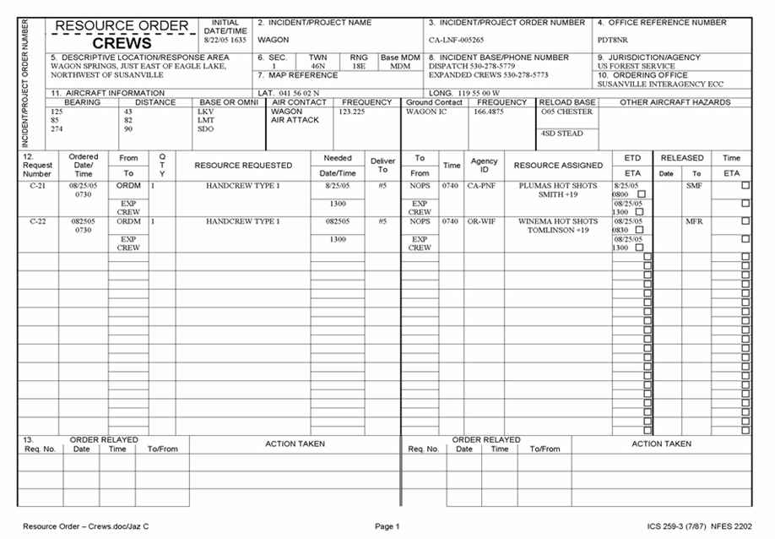
Resource Order Crews
Notes:
Crews

Slide 11
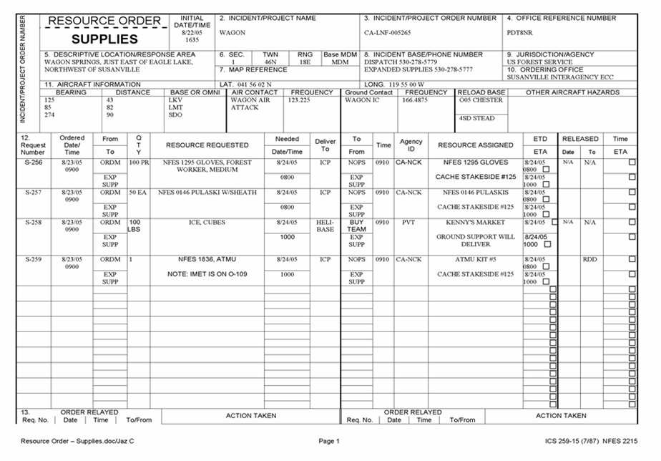
Resource Order Supplies
Notes:
Supplies

Slide 12
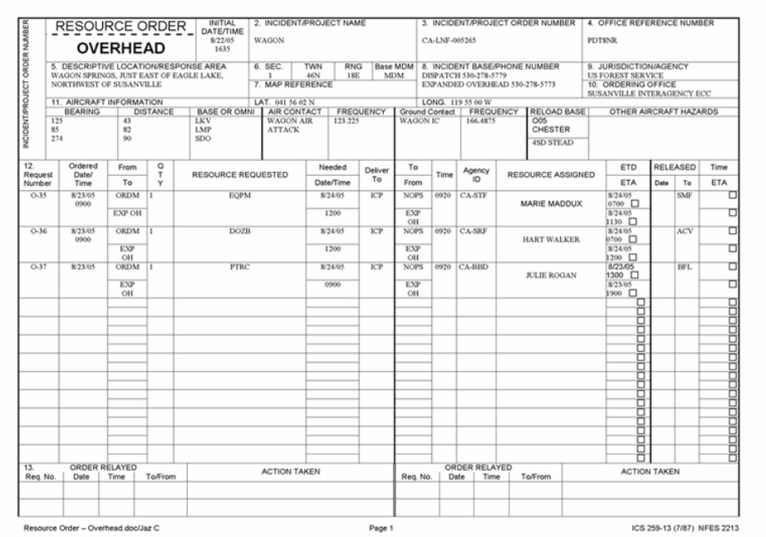
Resource Order Overhead
Notes:
Overhead
Refer students to the EDRC Reference Guide where they can find the “Block by Block Instructions”
EXERCISE: 20 Minutes
Purpose: Teaching students how to fill out a hardcopy resource order.
Format: Students work independently using handout as a guide.
Materials Needed:
GM 3 - SUBJECT: OH Order 2
Blank Overhead Resource Order Form
laptop with IROC
Instructions:
Have students locate handout GM 3 - SUBJECT: OH Order 2, requesting DIVS.
Assist students with filling out the hardcopy resource order form. When students have completed the electronic/hard copy resource order form, have them sign into IROC, locate the request, attach GM 3 – SUBJECT: OH Order 2 to the IROC request and “print” or “save”. Have students compare the hardcopy resource order form with the IROC resource order form for accuracy.
End of Exercise.

Slide 13
Objectives
Identify forms that supplement the Resource Order form
Complete a hardcopy of the Resource Order Form
Notes:
Review unit objectives.

